Slide 1
Software Architectural Styles

Slide 2
Architectural Style
An architectural style is a named collection of architectural design decisions that
are applicable in a given development context
constrain architectural design decisions that are specific to a particular system within that context
elicit beneficial qualities in each resulting system
A primary way of characterizing lessons from experience in software system design
Reflect less domain specificity than architectural patterns
Useful in determining everything from subroutine structure to top-level application structure

Slide 3
Definitions of Architectural Style
Recurring organizational patterns
Established, shared understanding of common design forms
Mark of mature engineering field.
Shaw & Garlan
Abstraction of recurring composition & interaction characteristics in a set of architectures
Taylor

Slide 4
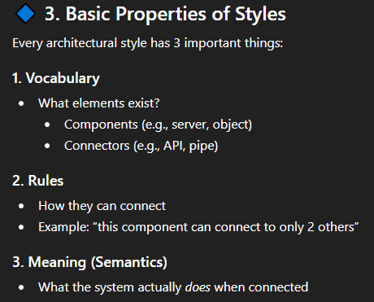
Basic Properties of Styles
A vocabulary of design elements
Component and connector types; data elements
e.g., pipes, filters, objects, servers
A set of configuration rules
Topological constraints that determine allowed compositions of elements
e.g., a component may be connected to at most two other components
A semantic interpretation
Compositions of design elements have well-defined meanings
Possible analyses of systems built in a style

Slide 5
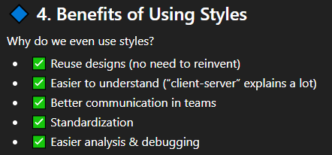
Benefits of Using Styles
Design reuse
Well-understood solutions applied to new problems
Code reuse
Shared implementations of invariant aspects of a style
Understandability of system organization
A phrase such as “client-server” conveys a lot of information
Interoperability
Supported by style standardization
Style-specific analyses
Enabled by the constrained design space
Visualizations
Style-specific depictions matching engineers’ mental models

Slide 6
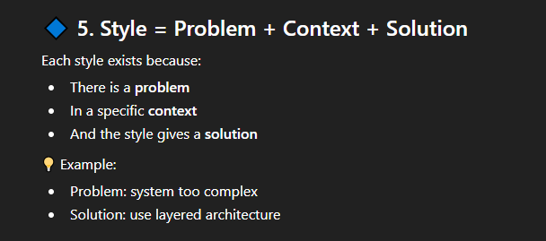
Architectural Style
A software architecture style is a solution to a recurring problem that is well understood, in a particular context.
Each style consists of a context, a problem, and a solution.
The problem may be to overcome some challenge, take advantage of some opportunity, or to satisfy one or more quality attributes.
Patterns codify knowledge and experience into a solution that we can reuse.
Using style simplifies design and allows us to gain the benefits of using a solution that is proven to solve a particular design problem.
When working with others who are familiar with style, referencing one of them provides a shorthand with which to reference a solution, without having to explain all its details.
As a result, they are useful during discussions to communicate ideas.
Each style has its own characteristics, strengths, and weaknesses.

Slide 7
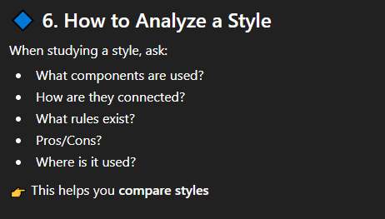
Style Analysis Dimensions
What is the design vocabulary?
Component and connector types
What are the allowable structural patterns?
What is the underlying computational model?
What are the essential invariants of the style?
What are common examples of its use?
What are the (dis)advantages of using the style?
What are the style’s specializations?

Slide 8
Some Common Styles
Traditional, language-influenced styles
Main program and subroutines
Object-oriented
Layered
Virtual machines
Client-server
Data-flow styles
Batch sequential
Pipe and filter
Shared memory
Blackboard
Rule based
Interpreter
Interpreter
Mobile code
Implicit invocation
Event-based
Publish-subscribe
Peer-to-peer
“Derived” styles
C2
CORBA

Slide 9
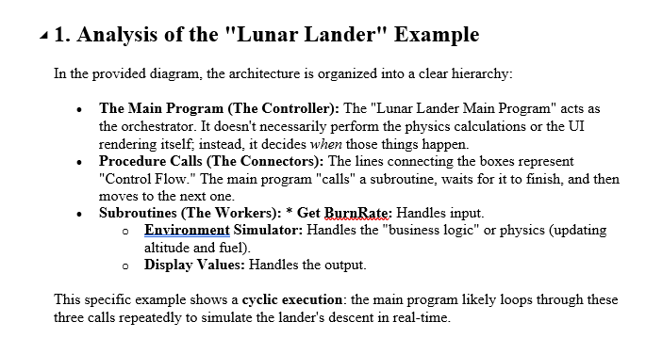
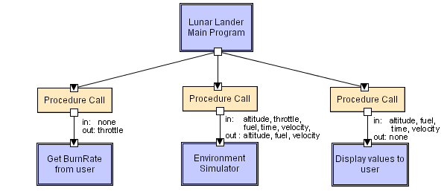
Main Program and Subroutines LL
Notes:
Main program displays greetings and instructions, then enters a loop in which it calls the three subroutines in turn.

Slide 10
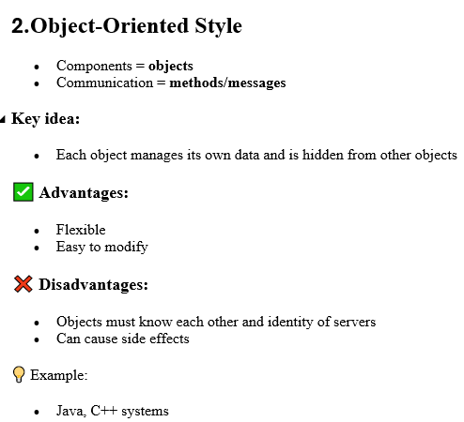
Object-Oriented Style
Components are objects
Data and associated operations
Connectors are messages and method invocations
Style invariants
Objects are responsible for their internal representation integrity
Internal representation is hidden from other objects
Advantages
“Infinite malleability” of object internals
System decomposition into sets of interacting agents
Disadvantages
Objects must know identities of servers
Side effects in object method invocations
Clean Code Vs Methods Invocation
Notes:
For example, simply using the right formula to compute the area of an enclosed shape will vary depending on if the shape is a triangle, rectangle, ellipse, or circle. In traditional computer programming this would result in long IF-THEN statements testing what sort of object the shape was and calling the appropriate code. The object-oriented way to handle this is to define a class called Shape with subclasses such as Rectangle and Ellipse (which in turn have subclasses Square and Circle) and then to simply send a message to any Shape asking it to compute its area. Each Shape object will then invoke the subclass's method with the formula appropriate for that kind of object.
Cache, buffer, stack, queue
Here are a few points of intersection between clean code and method invocation:
Meaningful Method Names: Clean code encourages using descriptive names for methods, which makes it clear what the method does. Meaningful method names make method invocations self-explanatory and improve the overall readability of the code.
Single Responsibility Principle (SRP): Clean code follows the Single Responsibility Principle, which states that a method should do one thing and do it well. When methods have a single responsibility, they are easier to invoke correctly, leading to more maintainable and understandable code.
Code Organization: Clean code promotes organizing methods and functions in a logical manner within classes or modules. Proper organization makes it easier to find and invoke the methods needed for specific tasks.
Avoiding Code Duplication: Clean code advocates for avoiding code duplication. When methods are well-organized and named appropriately, developers are more likely to reuse existing methods, reducing the need to write similar code multiple times.

Slide 11
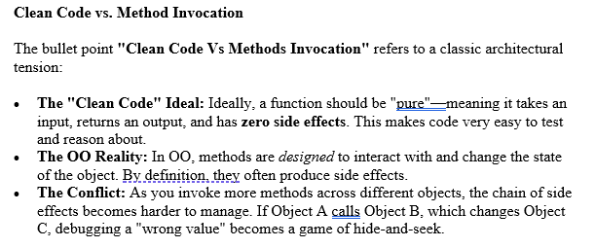
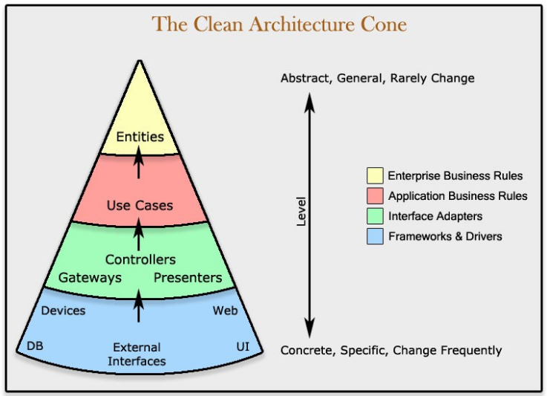
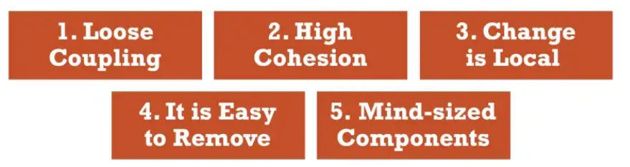
Clean Code
“The first rule of functions is that they should be small. The second rule of functions is that they should be smaller than that.” — Robert C. Martin
Notes:
1- Two machine learning components are coupled when at least one of them uses the other.
2-ML components that do change for different reasons or at different times should be kept separate.
3- Keeping ML components changes local means that there are boundaries in the design which changes do not cross.
4-When an ML block gets too complicated, it has to be removed and replaced with one or more simpler ML blocks.
5- Break your machine learning system down into Data/ML components into sizes you can grasp within your mind. The goal is to predict the consequences of changes easily (dependencies, control flow, etc,…).

Slide 12
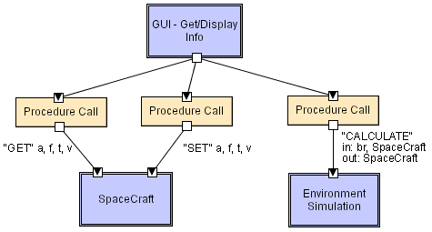
Object-Oriented LL
Notes:
Spacecrat: Altitude, fuel, time, velocity Br: BurnRate , Spacecraft SpaceCraft: get, set
BurnRate: The only flight control law in this game is translation of a pilot-specified throtle percentage into a volume/second fuel-flow setting (the BurnRate) to control the des

Slide 13
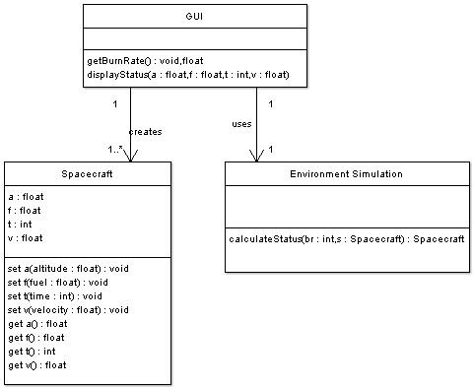
OO/LL in UML

Slide 14
Layered Style
Hierarchical system organization
“Multi-level client-server”
Each layer exposes an interface (API) to be used by above layers
Each layer acts as a
Server: service provider to layers “above”
Client: service consumer of layer(s) “below”
Connectors are protocols of layer interaction
Example: operating systems
Virtual machine style results from fully opaque layers

Slide 15
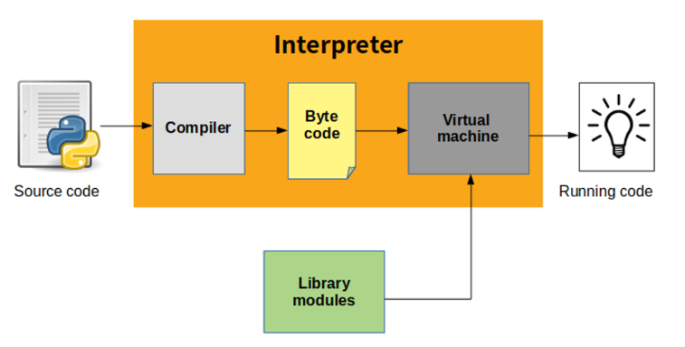
Layered Style

Slide 16
Layered Style (cont’d)
Advantages
Increasing abstraction levels
Evolvability
Changes in a layer affect at most the adjacent two layers
Reuse
Different implementations of layer are allowed as long as interface is preserved
Standardized layer interfaces for libraries and frameworks

Slide 17
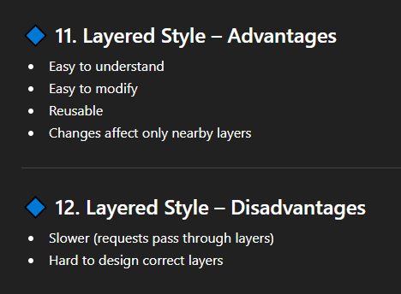
Layered Style (cont’d)
Disadvantages
Not universally applicable
Performance
Layers may have to be skipped
Determining the correct abstraction level

Slide 18
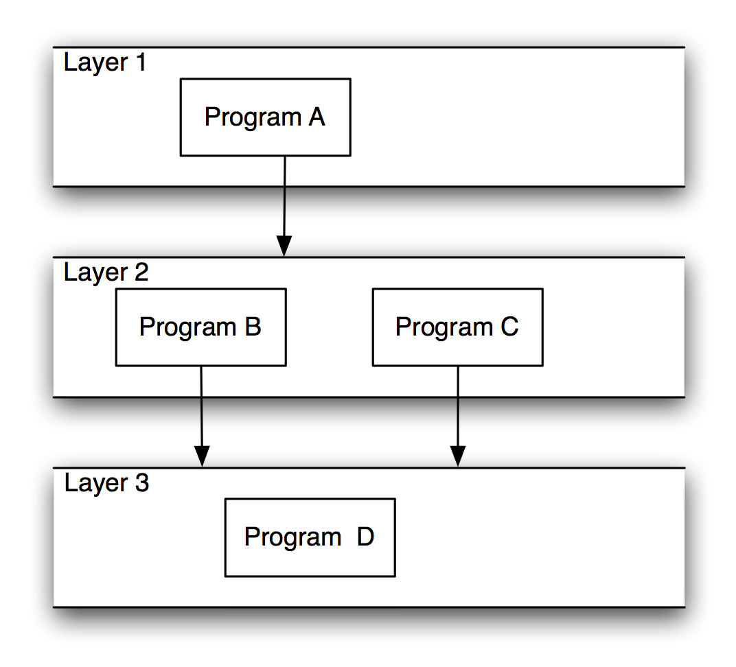
Layered Systems/Virtual Machines

Slide 19
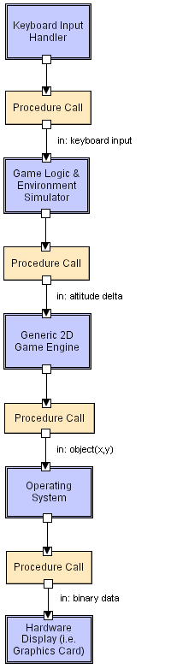
Layered LL

Slide 20
Client-Server Style
Components are clients and servers
Servers do not know number or identities of clients
Clients know server’s identity
Connectors are RPC-based network interaction protocols

Slide 21
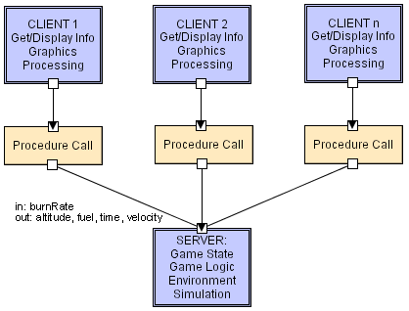
Client-Server LL

Slide 22
Layered Architecture
Context:
All complex systems experience the need to develop and evolve portions of the system independently.
For this reason the developers of the system need a clear and well-documented separation of concerns, so that modules of the system may be independently developed and maintained.
Problem:
The software needs to be segmented in such a way that the modules can be developed and evolved separately with little interaction among the parts, supporting portability, modifiability, and reuse.
Solution:
the layered pattern divides the software into units called layers.
Each layer is a grouping of modules that offers a cohesive set of services.
It is one of the most common techniques.
In a layered architecture, the software application is divided into various horizontal layers, with each layer located on top of a lower layer.

Slide 24
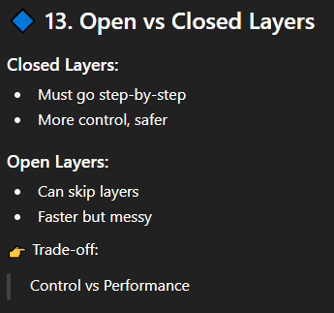
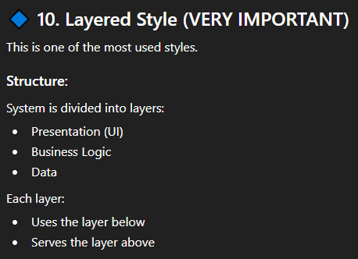
Open versus closed layers
With a closed layer, requests that are flowing down the stack from the layer above must go through it and cannot bypass it.
Example:
three-layer architecture with presentation, business, and data layers
if the business layer is closed, the presentation layer must send all requests to business layer and cannot bypass it to send a request directly to the data layer.
Closed layers provide layers of isolation, which makes code easier to change, write, and understand.
This makes the layers independent of each other, such that changes made to one layer of the application will not affect components in the other layers.
If the layers are open, this increases complexity.
Maintainability is lowered because multiple layers can now call into another layer, increasing the number of dependencies and making changes more difficult.

Slide 25
Open versus closed layers
Presentation
Presentation
Unnecessary traffic can result when each layer must be passed even if one or more of them is just passing requests on to the next layer.
added a shared services layer between the business and data layers.
may contain reusable components needed by multiple components in the business layer.
placed it below the business layer so that only the business layer has access to it.
all requests from the business layer to the data layer must go through the shared services layer even though nothing is needed from that layer.
If the shared services layer was made open (aka layer bridging), requests to the data layer can be made directly from the business layer.
there are advantages to closed layers and achieving layers of isolation.
However, it might be appropriate to open a layer.
It is not necessary to make all of the layers open or closed.
You may selectively choose which layers, if any, are open.
Business
Business
Shared-Service
Data

Slide 26
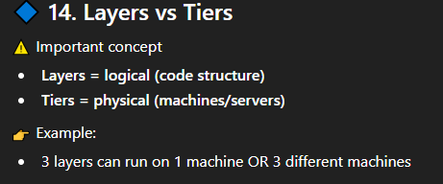
Layered Architecture
Layers – Logical separation
Tiers – Physical separation
When partitioning application logic, layers are a way to organize functionality and components.
For example, in a three-layered architecture, the logic may be separated into presentation, business, and data layers.
When a software architecture is organized into more than one layer, it is known as a multi-layer architecture.
Different layers do not necessarily have to be located on different physical machines.
It is possible to have multiple layers on the same machine.
Tiers concern themselves with the physical location of the functionality and components.
Presentation
Business
Data

Slide 27
Layered Architecture
A three-tiered architecture with presentation, business, and data tiers implies that those three tiers have been physically deployed to three separate machines and are each running on those separate machines.
When a software architecture is partitioned into multiple tiers, it is known as a multi-tier architecture.

Slide 28
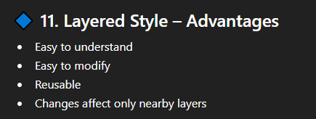
Advantages of layered architectures
This pattern reduces complexity by achieving a Separation of Concerns (SoC).
Each layer is independent and you can understand it on its own without the other layers.
Complexity can be abstracted away in a layered application, allowing us to deal with more complex problems.
Dependencies between layers can be minimized in a layered architecture, which further reduces complexity.
For example, the presentation layer does not need to depend directly on the data layer and the business layer does not depend on the presentation layer.
Minimizing dependencies also allows you to substitute implementations for a particular layer without affecting the other layers.

Slide 29
Advantages of layered architectures
they can make development easier.
The pattern is pervasive and well known to many developers, which makes using it easy for the development team.
Due to the way that the architecture separates the application logic, it matches up well with how many organizations hire their resources and allocate tasks during a project.
Each layer requires a particular skill set and suitable resources can be assigned to work on each layer.
For example, UI developers for the presentation layer, and backend developers for the business and data layers.

Slide 30
Advantages of Layered Architectures
This architecture pattern increases the testability quality attribute of software applications.
Partitioning the application into layers and using interfaces for the interaction between layers allows us to isolate a layer for testing and either mock or stub the other layers.
For example, you can perform unit testing on classes in your business layer without the presentation and data layers.
The business layer is not dependent on the presentation layer and the data layer can be mocked or stubbed.
Applications using a layered architecture may have higher levels of reusability if more than one application can reuse the same layer.
For example, if multiple applications target the same business and/or data layers, those layers are reusable.
Notes:
Stub: You're testing a UserRegistrationService that needs to check if a username is available via an external UserDatabase service. You want to test how the registration service handles a specific scenario where the username is already taken. A simple, hard-coded implementation of the UserDatabase interface that, when its isUsernameAvailable() method is called, always returns false for a specific test username. The test then asserts that the UserRegistrationService correctly sets the user's status to "unavailable" (state verification).
Mock: Consider testing a OrderProcessor that needs to call an EmailService to send a confirmation email after an order is placed. The goal is not just to see if the order status changes (state), but to ensure that the email service's send_email method was indeed called with the correct arguments (behavior)
A simulated EmailService that records the calls it receives. After the test runs the OrderProcessor, the test code uses the mock to assert that send_email was called exactly once, with the correct recipient and email body.

Slide 31
Advantages of layered architectures
When an application using a layered architecture is deployed to different tiers, there are additional benefits:
increased scalability as more hardware can be added to each tier
greater levels of availability when multiple machines are used per layer.
Uptime is increased because, if a hardware failure takes place in a layer, other machines can take over.
Having separate tiers enhances security as firewalls can be placed in between the various layers.
If a layer can be reused for multiple applications, it means that the physical tier can be reused as well.

Slide 32
Disadvantages of layered architectures
Although the layers can be designed to be independent, a requirement change may require changes in multiple layers.
This type of coupling lowers the overall agility of the software application.
For example, adding a new field will require changes to multiple layers: the presentation layer so that it can be displayed, the business layer so that it can be validated/saved/processed, and the data layer because it will need to be added to the database.
This can complicate deployment because, even for a change such as this, an application may require multiple parts (or even the entire application) to be deployed.
more code will be necessary for layered applications.
This is to provide the interfaces and other logic that are necessary for the communication between the multiple layers.

Slide 33
Disadvantages of layered architectures
Development teams have to be diligent about placing code in the correct layer so as not to leak logic to a layer that belongs in another layer.
Examples of this include placing business logic in the presentation layer or putting data-access logic in the business layer.
there can be inefficiencies in having a request go through multiple layers.
moving from one layer to another sometimes requires data representations to be transformed.
One way to mitigate this disadvantage is to allow some layers to be open but this should only be done if it is appropriate to open a layer.
disadvantages to layered architectures when they are deployed to multiple tiers:
when layers are deployed to separate physical tiers, there is an additional performance cost.
With modern hardware, this cost may be small but it still won't be faster than an application that runs on a single machine.

Slide 34
Disadvantages of layered architectures
There is a greater monetary cost associated with having a multi-tier architecture.
The more machines are used for the application, the greater the overall cost.
Unless the hosting of the software application is handled by a cloud provider or has otherwise been outsourced, an internal team will be needed to manage the physical hardware of a multi-tier application.

Slide 35
Two-tier Architecture
client-server architecture, also known as a two-tier architecture
distributed application
clients and servers communicate with each other directly.
A client requests some resource or calls some service provided by a server and the server responds to the requests of clients.
There can be multiple clients connected to a single server
The Client part of the application contains the user interface code and the Server contains the database
The majority of application logic in a client-server architecture is located on the server, but some of it could also be located in the client.
The application logic located on the server might exist in software components, in the database, or both.

Slide 36
Two-tier Architecture
When the client contains a significant portion of the logic and is handling a large share of the workload, it is known as a thick, or Fat client.
When the server is doing that instead, the client is known as a Thin client.
In some client-server applications, the business logic is spread out between the client and the server.
If consistency isn't applied, it can make it difficult to always know where a particular piece of logic is located.
If a team isn't diligent, business logic might be duplicated on the client and the server.
There may be instances in which the same piece of logic is needed on both the client and the server.
For example, there may be business logic needed by the user interface to validate a piece of data prior to submitting the data to the server. The server may need this same business logic because it also needs to perform this validation.
While centralizing this logic may require additional communication between the client and the server, the alternative (duplication) lowers maintainability.
If the business logic were to change, it would have to be modified in multiple places.

Slide 37
N-tier Architecture
also known as a multitier architecture
there are multiple tiers in the architecture.
One of the most widely-used variations of this type of layered architecture is the three-tier architecture.
The three-tier architecture separates logic into presentation, business, and data layers.

Slide 38
Presentation tier
The presentation tier provides functionality for the application's UI.
It should provide an appealing visual design as it is the part of the application that users interact with and see.
Data is presented to the user and input is received from users in this tier.
Aspects of the usability quality attribute should be the concern of the presentation tier.
Software architects should strive to design thin clients that minimize the amount of logic that exists in the presentation tier.
The logic in the presentation tier should focus on user interface concerns.
A presentation tier devoid of business logic will be easier to test.

Slide 39
Business tier
The business tier, which is sometimes referred to as the application tier, provides the implementation for the business logic of the application, including such things as business rules, validations, and calculation logic.
Business entities for the application's domain are placed in this tier.
The business tier coordinates the application and executes logic.
It can perform detailed processes and makes logical decisions.
The business tier is the center of the application and serves as an intermediary between the presentation and data tiers.
It provides the presentation tier with services, commands, and data that it can use, and it interacts with the data tier to retrieve and manipulate data.

Slide 40
Data tier
The data tier provides functionality to access and manage data.
The data tier contains a data store for persistent storage, such as an RDBMS.
It provides services and data for the business tier.
The rise of the web coincided with a shift from two-tier (client-server) architectures to three-tier architectures.
With web applications and the use of web browsers, rich client applications containing business logic were not ideal.

Slide 41
Data-Flow Styles
Batch Sequential
Separate programs are executed in order; data is passed as an aggregate from one program to the next.
Connectors: “The human hand” carrying tapes between the programs, a.k.a. “sneaker-net ”
Data Elements: Explicit, aggregate elements passed from one component to the next upon completion of the producing program’s execution.
Typical uses: Transaction processing in financial systems. “The Granddaddy of Styles”

Slide 42
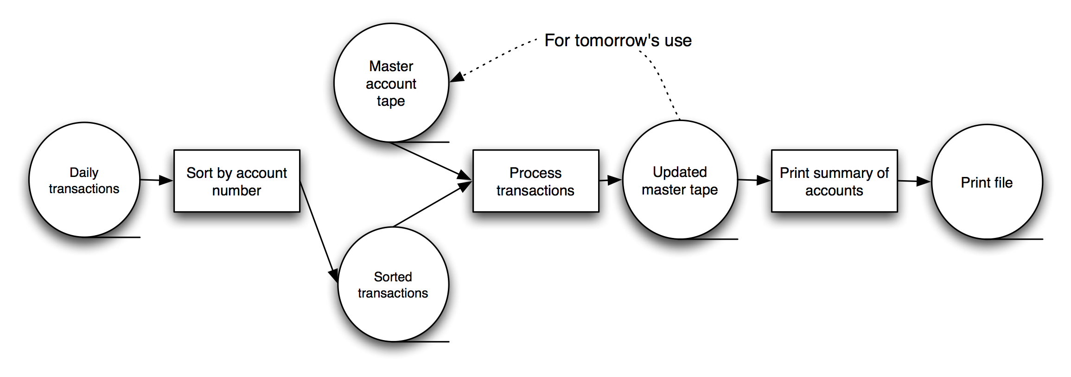
Batch-Sequential: A Financial Application

Slide 43
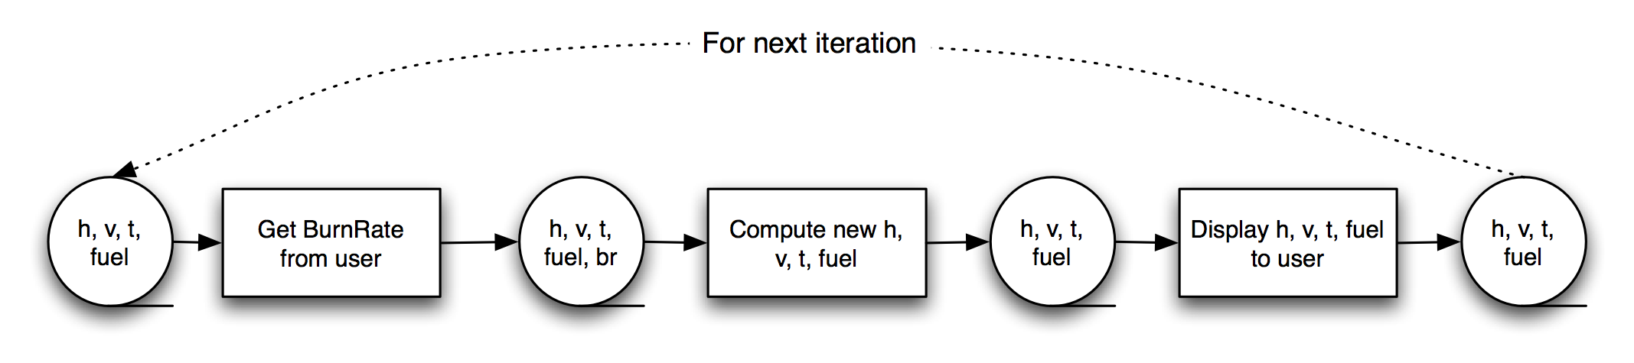
Batch-Sequential LL
Not a recipe for a successful lunar mission!

Slide 44
Pipe and Filter Style
Components are filters
Transform input data streams into output data streams
Possibly incremental production of output
Connectors are pipes
Ducts for data streams
Style invariants
Filters are independent (no shared state)
Filter has no knowledge of up- or down-stream filters
Examples
Distributed systems parallel programming

Slide 45
Pipe and Filter Style
Context: Many systems are required to transform streams of discrete data items, from input to output.
Many types of transformations occur repeatedly in practice, and so it is desirable to create these as independent, reusable parts.

Slide 46
Pipe and Filter Style
Problem: Such systems need to be divided into reusable, loosely coupled components with simple, generic interaction mechanisms.
In this way they can be flexibly combined with each other.
The components, being generic and loosely coupled, are easily reused.
The components, being independent, can execute in parallel.

Slide 47
Pipe and Filter Style
Solution: The pattern of interaction in the pipe-and-filter pattern is characterized by successive transformations of streams of data.
Data arrives at a filter’s input port(s), is transformed, and then is passed via its output port(s) through a pipe to the next filter.
A single filter can consume data from, or produce data to, one or more ports.

Slide 48
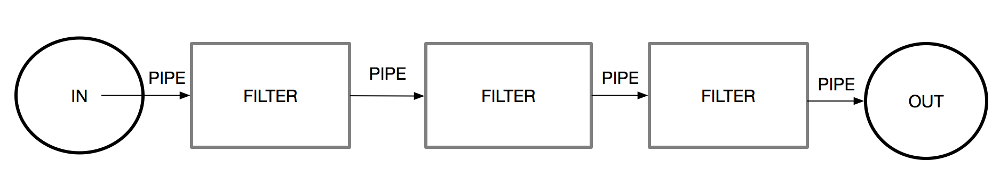

Slide 49
Strength and Weakness
Typically not a good choice for an interactive system, as it disallows cycles (which are important for user feedback).
Having large numbers of independent filters can add substantial amounts of computational overhead, because each filter runs as its own thread or process.
May not be appropriate for long-running computations, without the addition of some form of checkpoint/restore functionality, as the failure of any filter (or pipe) can cause the entire pipeline to fail.
Pipes buffer data during communication. Because of this property, filters can execute asynchronously and concurrently.

Slide 50
Strength and Weakness
A filter typically does not know the identity of its upstream or downstream filters. For this reason, pipeline pipe-and-filter systems have the property that the overall computation can be treated as the functional composition of the computations of the filters, making it easier for the architect to reason about end-to-end behavior.

Slide 51
Strength and Weakness
Data transformation systems are typically structured as pipes and filters, with each filter responsible for one part of the overall transformation of the input data.
The independent processing at each step supports reuse, parallelization, and simplified reasoning about overall behavior.

Slide 52
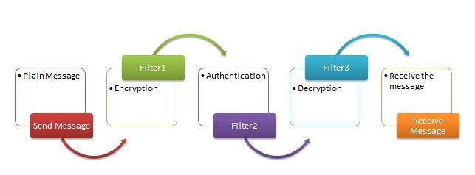

Slide 53
Examples of Pipe-and-Filter Architecture
Systems built using UNIX pipes
The request processing architecture of the Apache web server
Yahoo! Pipes for processing RSS feeds
Many workflow engines
Many scientific computation systems that have to process and analyze large streams of captured data.

Slide 54
Pipe and Filter (cont’d)
Variations
Pipelines — linear sequences of filters
Bounded pipes — limited amount of data on a pipe
Typed pipes — data strongly typed
Advantages
System behavior is a succession of component behaviors
Filter addition, replacement, and reuse
Possible to hook any two filters together
Certain analyses
Throughput, latency, deadlock
Concurrent execution
Notes:
The time it takes for a packet to travel from the source to its destination is referred to as latency. Latency indicates how long it takes for packets to reach their destination. Throughput is the term given to the number of packets that are processed within a specific period of time.
The throughput of a CPU pipeline is the # of instructions completed per second.
Throughput - Number of processes completed per unit time. May range from 10 / second to 1 / hour depending on the specific processes. Turnaround time - Time required for a particular process to complete, from submission time to completion.

Slide 55
Pipe and Filter (cont’d)
Disadvantages
Batch organization of processing
Interactive applications
Lowest common denominator on data transmission

Slide 56

Pipe and Filter LL
Notes:
GetBurnRate runs continuously on its own, prompting the user for a new burn rate.
In this design the “compute new values” determines how much time has passed. Could alternatively do that in the GetBurnRate filter. Would change semantics a bit.

Slide 57
Blackboard Style
Two kinds of components
Central data structure — blackboard
Components operating on the blackboard
System control is entirely driven by the blackboard state
Examples
Typically used for AI systems

Slide 58
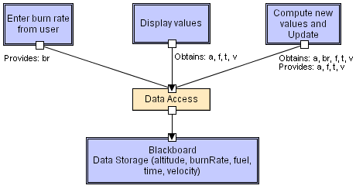
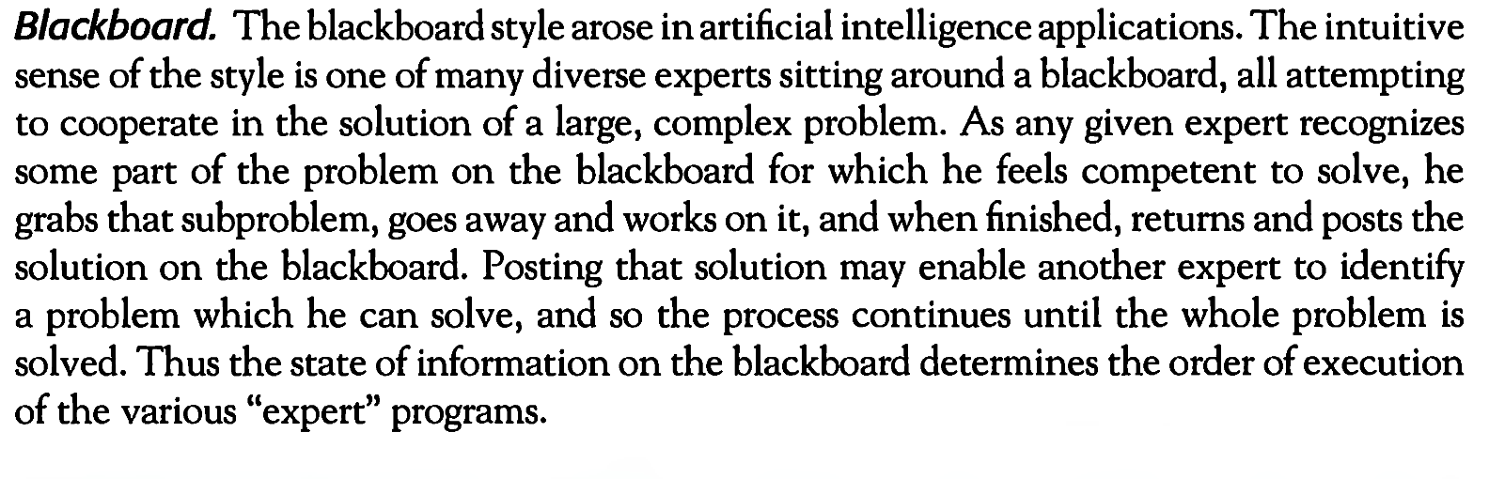

Slide 59
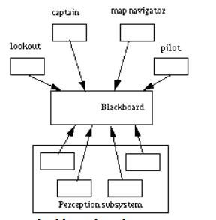
Blackboard Style
The "captain", the overall supervisor.
The "map navigator", the high level path planner.
The "lookout", a module that monitors the environment for landmarks.
The "pilot", the low level path planner and motor controller.
Mobile Robot

Slide 60
Rule-Based Style
Inference engine parses user input and determines whether it is a fact/rule or a query. If it is a fact/rule, it adds this entry to the knowledge base. Otherwise, it queries the knowledge base for applicable rules and attempts to resolve the query.
Notes:
Definition. In the shared-memory architecture, the entire memory, i.e., main memory and disks, is shared by all processors. A special, fast interconnection network (e.g., a high-speed bus) allows any processor to access any part of the memory in parallel.

Slide 61

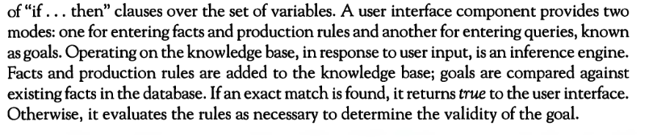
Rule-Based Style

Slide 62
Rule-Based Style (cont’d)
Components: User interface, inference engine, knowledge base
Connectors: Components are tightly interconnected, with direct procedure calls and/or shared memory.
Data Elements: Facts/rules and queries
Behavior of the application can be very easily modified through addition or deletion of rules from the knowledge base. E.g., Car price prediction
Caution: When a large number of rules are involved understanding the interactions between multiple rules affected by the same facts can become very difficult.
This is where ML and DL comes into business.

Slide 63
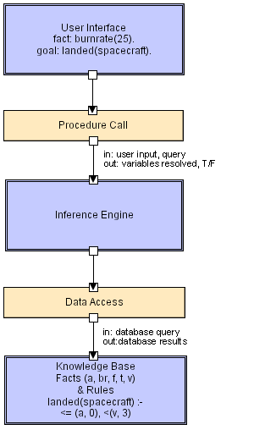
Rule Based LL
Goal = Query

Slide 64
Interpreter Style
Interpreter parses and executes input commands, updating the state maintained by the interpreter
Components: Command interpreter, program/interpreter state, user interface.
Connectors: Typically very closely bound with direct procedure calls and shared state.
Highly dynamic behavior possible, where the set of commands is dynamically modified. System architecture may remain constant while new capabilities are created based upon existing primitives.
Superb for end-user programmability; supports dynamically changing set of capabilities
Notes:
NLTK contains a module called tokenize() which further classifies into two sub-categories: Word tokenize: We use the word_tokenize() method to split a sentence into tokens or words. Sentence tokenize: We use the sent_tokenize() method to split a document or paragraph into sentences.
A parser is a compiler or interpreter component that breaks data into smaller elements for easy translation into another language. A parser takes input in the form of a sequence of tokens, interactive commands, or program instructions and breaks them up into parts that can be used by other components in programming.
Definition. In the shared-memory architecture, the entire memory, i.e., main memory and disks, is shared by all processors. A special, fast interconnection network (e.g., a high-speed bus) allows any processor to access any part of the memory in parallel.

Slide 65
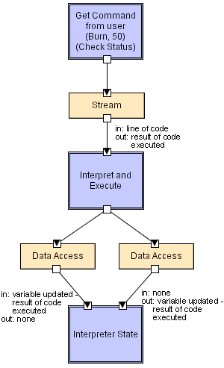
Interpreter LL
=IF(Something is True, then do something, otherwise do something else)
=IF(B2>97,"A+",IF(B2>93,"A",IF(B2>89,"A-",IF(B2>87,"B+",IF(B2>83,"B",IF(B2>79,"B-", IF(B2>77,"C+",IF(B2>73,"C",IF(B2>69,"C-",IF(B2>57,"D+",IF(B2>53,"D",IF(B2>49,"D-","F"))))))))))))
Software Architecture: Foundations, Theory, and Practice; Richard N. Taylor, Nenad Medvidovic, and Eric M. Dashofy; © 2008 John Wiley & Sons, Inc. Reprinted with permission.

Slide 66
Interpreter Style
Interpreter architecture is used in systems that execute instructions dynamically at runtime.
Instead of compiling the entire program beforehand, the system:
Reads → Parses → Executes instructions one by one
This allows immediate execution and flexibility in handling dynamic inputs.
How It Works
Read: Take input (code, command, or expression)
Parse: Check syntax and understand structure
Execute: Perform the required operation

Slide 67
Interpreter Style
The interpreter executes code one statement at a time instead of translating the whole program at once.
The program does not need to be converted into machine code beforehand. This reduces setup time and allows quick testing.
New instructions can be added, modified, and executed during runtime.
Each instruction is:
Read → Parsed → Executed repeatedly
This adds overhead compared to compiled programs, which are already translated into machine code.

Slide 68
Interpreter Style
Advantages
Easy to Use and Rapid Development
Immediate Feedback (Debugging Friendly)
Code can be modified and executed at runtime
Same code can run on different systems (as long as interpreter exists)
Disadvantages
Each line is interpreted at runtime
Program cannot run without the interpreter installed
Performance overhead becomes significant in large applications
Errors are only detected during execution (not before)

Slide 69
Implicit Invocation Publish-Subscribe Style
Publish–Subscribe (Pub/Sub) is an architectural style where:
Publishers send messages (events/data)
Subscribers receive messages they are interested in
Publishers and subscribers do not know each other directly
How It Works
Publisher sends a message to a topic/channel
System manages the message
Subscribers who subscribed to that topic receive updates

Slide 70
Publish-Subscribe Style
Key Feature: Loose Coupling
Publishers don’t know who receives the message
Subscribers don’t know who sent it
This makes the system:
Flexible
Scalable
Easy to extend

Slide 71
Publish-Subscribe Style
Advantages
Very Loose Coupling
High Scalability
Asynchronous Communication
Efficient Message Distribution
Disadvantages
Complex System Design
Difficult Debugging & Tracking
Message Delivery Issues

Slide 72
Publish-Subscribe (cont’d)
Components: Publishers, subscribers, proxies for managing distribution
Connectors: Typically a network protocol is required. Content-based subscription requires sophisticated connectors.
Data Elements: Subscriptions, notifications, published information
Topology: Subscribers connect to publishers either directly or may receive notifications via a network protocol from intermediaries
Qualities yielded Highly efficient one-way dissemination of information with very low-coupling of components

Slide 73
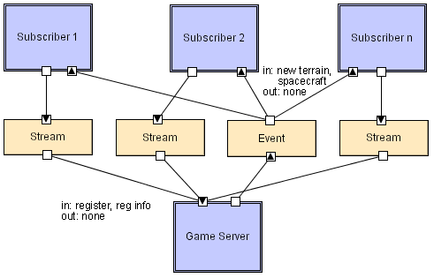
Pub-Sub LL
Software Architecture: Foundations, Theory, and Practice; Richard N. Taylor, Nenad Medvidovic, and Eric M. Dashofy; © 2008 John Wiley & Sons, Inc. Reprinted with permission.

Slide 74
Event-Based Style
Independent components asynchronously emit and receive events communicated over event buses
Components: Independent, concurrent event generators and/or consumers
Connectors: Event buses (at least one)
Data Elements: Events – data sent over the event bus
Topology: Components communicate with the event buses.
Variants: Component communication with the event bus may either be push or pull based.
Highly scalable, easy to evolve, effective for highly distributed applications.
Notes:
Any recipient may query the connector to see if new event is available
Pull : would like to fetch the information, blocking (query process will keep on waiting until a response about new event is received), non-blocking (outcome of the query will be received irrespective of new even available or not)
Push: recipient would want the information to be disseminated.

Slide 75
Event-Based Style
Event-Based or Implicit Invocation architecture is based on events triggering actions.
Components do not directly call each other
Instead, they emit events, and other components listen and respond
Communication is indirect and loosely coupled
How It Works
An event occurs (e.g., user action, system change)
The event is broadcasted
Interested components (listeners/subscribers) react

Slide 76
Event-Based Style
Advantages
Loose Coupling
High Flexibility & Extensibility
Supports Asynchronous Processing
Good for Interactive Systems
Disadvantages
Hard to Understand Flow
Debugging is Difficult
Performance Overhead
Unpredictable Behavior

Slide 77
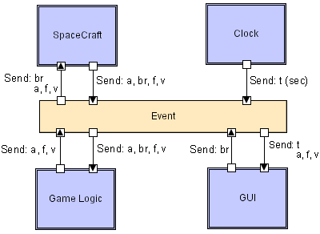
Event-based LL
Software Architecture: Foundations, Theory, and Practice; Richard N. Taylor, Nenad Medvidovic, and Eric M. Dashofy; © 2008 John Wiley & Sons, Inc. Reprinted with permission.

Slide 78
Peer-to-Peer Style
State and behavior are distributed among peers which can act as either clients or servers.
Peers: independent components, having their own state and control thread.
Connectors: Network protocols, often custom.
Data Elements: Network messages

Slide 79
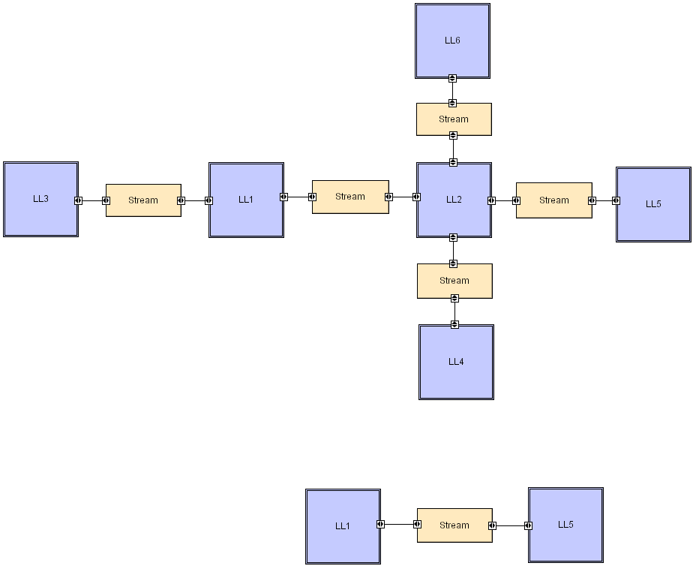
Peer-to-Peer LL
Software Architecture: Foundations, Theory, and Practice; Richard N. Taylor, Nenad Medvidovic, and Eric M. Dashofy; © 2008 John Wiley & Sons, Inc. Reprinted with permission.

Slide 80
Peer-to-Peer Style (cont’d)
Topology: Network (may have redundant connections between peers); can vary arbitrarily and dynamically
Supports decentralized computing with flow of control and resources distributed among peers. Highly robust in the face of failure of any given node. Scalable in terms of access to resources and computing power. But caution on the protocol!
Notes:
Network redundancy is a process through which additional or alternate instances of network devices, equipment and communication mediums are installed within network infrastructure. It is a method for ensuring network availability in case of a network device or path failure and unavailability.

